Slide 1
INT332
Lecture Zero
Devops Virtualization And Configuration Management

Slide 2
VISION
To be a globally recognized school through excellence in teaching, learning and research for creating Computer Science professionals, leaders and entrepreneurs of future contributing to society and industry for sustainable growth

Slide 3
MISSION
To build computational skills through hands-on and practice-based learning with measurable outcomes.
To establish a strong connect with industry for in-demand technology driven curriculum.
To build the infrastructure for meaningful research around societal problems.
To nurture future leaders through research-infused education and lifelong learning.
To create smart and ethical professionals and entrepreneurs who are recognized globally

Slide 4


Course Overview
This course introduces students to DevOps foundations through containerization, virtualization, and automated software delivery pipelines.
Focus on Docker, microservices, and CI/CD workflows using tools such as Docker Compose, Maven, GitHub Actions, and Jenkins for building and deploying modern applications.

Slide 5

L T P
Lecture - 2
Tutorial - 0
Practical - 2
Credits – 3

Slide 6
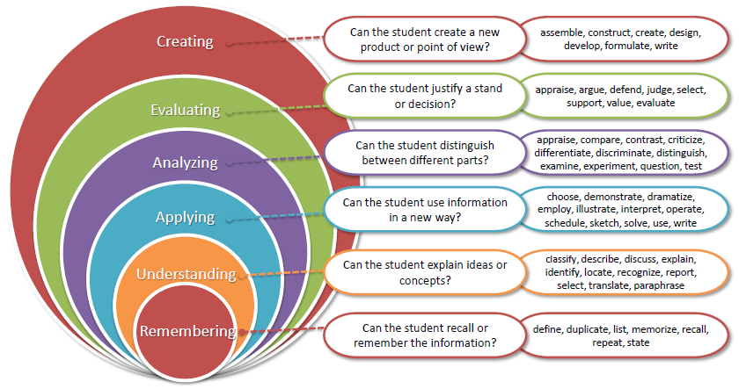
Revised Bloom’s Taxonomy

Slide 7
Unit:-1 Basics of DevOps Infrastructure
Introduction to Containers (Origin of containers, Emergence of Modern Containerization and Integration into DevOps), Container runtime, Process isolation & namespaces, Control Groups (cgroups) for resource limits, Container images & layers, Image registries & distribution, Introduction to Docker, Docker Architecture, Docker daemon, Docker CLI, Docker registry & Hub, Object types: container, image, network, volume, Docker layering & filesystem

Slide 8
Unit:-2 Image Building & Container Management
Docker file Core Concepts: Image layering, Build context & .dockerignore, Dockerfile writing, Basic instructions ( FROM, RUN, COPY, ADD, CMD, ENTRYPOINT, WORKDIR, ENV, EXPOSE, VOLUME etc),, Image Creation in Detail: docker build process, Images Tagging /versioning, Inspecting images (history, layers), Docker Networking: Bridge network, Host & overlay networks, DNS inside Docker, Linking containers, Port mapping between host and container, Docker Storage: Volumes vs bind mounts, backing data on host, , Copy-on-write mechanism, Registries: Docker Hub, GitHub Container Registry (GHCR),, Private registries, Authentication & access tokens.

Slide 9
Unit:-3 Microservices with Docker Compose
Microservices Architecture: Need for microservices, Monolithic vs microservices, Advantages: scalability, isolation, agility, API Gateway., Docker Compose: YAML Structure, Writing docker-compose.yml, version, services, volumes, networks, Environment variables, Secrets and configs, Build vs image fields in YAML, Service dependency ordering., Use Case Deployments: Multi-container apps (database + backend + frontend), WordPress + MySQL, Node.js + MongoDB, Java Spring Boot + PostgreSQL.

Slide 10
Unit:-4 Maven Build Automation
Why build tools exist, Problems solved by automated builds, Project Object Model (POM), Directory structure, Build lifecycle phases, validate, compile, test, package, verify, install, deploy, Parent POM, Dependency scope, Transitive dependencies, Version conflicts & resolution, Using dependency Management, Maven Plugins & Execution: Compiler plugin, Surefire plugin (unit testing), Shade plugin (uber jar), Maven wrapper (mvnw), Maven and Docker Integration: dockerfile-maven-plugin, Dockerizing Maven-based applications, Pushing artifacts to registries.

Slide 11
Unit:-5 Continuous Integration (CI) with GitHub Actions
Understanding workflow automation, Events, triggers, workflow directory structure, Key components: workflows, Key components: jobs, steps, actions, runners, Workflow triggers: push, pull request, schedule, , manual workflow, Jobs & matrix strategies, Steps & shell commands, Using marketplace actions, Language-specific actions, Using caching for faster builds, Multi-job workflows, Deploying to servers/cloud using Actions, Runners: GitHub-hosted runners, Runners:Self-hosted runners ,Runner security & management, Docker &GitHub Actions: Building Docker images in CI, Pushing to Docker Hub, Pushing to GitHub Container Registry (GHCR), Deployments to servers/clouds

Slide 12
Unit:-6 CI/CD with Jenkins
Jenkins architecture (Master/Agent model), Installation & UI overview, Plugins management, Security, users, roles, Jenkins Pipelines: Freestyle vs Pipeline jobs, Declarative pipeline syntax, Scripted pipeline syntax, Jenkinsfile structure, Parameters,environment variables, Jenkins multi-branch pipelines, Pipeline Stages: Checkout code from Git,Build, Test, Package, Post actions, Managing artifacts, Docker and Jenkins Integration: Building Docker images using Jenkins, Docker inside Jenkins agents, Using Docker plugins, Publishing images to Docker Hub/GHCR, Jenkins and GitHub integration, Backup & restore, Pipeline best practices., Jenkins and Maven: Maven installation in Jenkins, Global tool configuration, Running Maven builds in pipelines, Code coverage & test reports, Jenkins CI/CD Deployment Flows: Triggering builds (pollSCM, webhook), Pipeline libraries, Jenkins agents (SSH/SFTP/Container-based), Deployments to servers/clouds

Slide 13
List of Practicals
Installing Docker on Windows/Linux, Concept of Hyper-V, Basic Docker commands.
Create a Docker-hub account, Pushing the Docker to container-hub, Saving changes to a Docker
container.
Creating a Docker file
Types of Docker storage, Linking docker container
Introduction to micro services
Docker compose installation, Introduction to YAML files, Writing a Docker Compose file, deploying
WordPress using docker compose.
Introduction to container orchestration
Creating a Docker swarm cluster, Initializing Docker Swarm create a service in a Docker Swarm.
Introduction to Docker networks, Creating a service.
Introduction to continuous integration.
Jenkins Architecture, Installing Jenkins.
Managing nodes on Jenkins.
Understanding CI / CD Pipelines, Creating CI / CD Pipelines.

Slide 14
COURSE OUTCOMES
CO1 :: Explain DevOps infrastructure concepts including containerization, runtimes, process isolation, namespaces, and resource management mechanisms.
CO2 :: Apply Docker concepts to build, manage, and distribute container images using networking, storage, and registries.
CO3 :: Construct microservices applications using Docker Compose with multi-container services and dependency configuration.
CO4 :: Analyze and implement automated builds using Maven through lifecycle management, dependency control, plugins, and Docker integration.
CO5 :: Apply Continuous Integration workflows using GitHub Actions for automated builds, testing, image creation, and deployment.
CO6 :: Develop end-to-end CI/CD pipelines using Jenkins integrating source control, build tools, containers, and deployments

Slide 15
PROGRAM OUTCOMES
PO-1 Engineering knowledge::Apply the knowledge of mathematics, science, engineering fundamentals, and an engineering specialization to the solution of complex engineering problems.
PO-2 Problem analysis::Identify, formulate, research literature, and analyze complex engineering problems reaching substantiated conclusions using first principles of mathematics, natural sciences, and engineering sciences.
PO-3 Design/development of solutions::Design solutions for complex engineering problems and design system components or processes that meet the specified needs with appropriate consideration for the public health and safety, and the cultural, societal, and environmental considerations.
PO-4 Conduct investigations of complex problems::Use research-based knowledge and research methods including design of experiments, analysis and interpretation of data, and synthesis of the information to provide valid conclusions.
PO-5 Modern tool usage::Create, select, and apply appropriate techniques, resources, and modern engineering and IT tools including prediction and modeling to complex engineering activities with an understanding of the limitations.

Slide 16
PO-6 The engineer and society::Apply reasoning informed by the contextual knowledge to assess societal, health, safety, legal and cultural issues and the consequent responsibilities relevant to the professional engineering practice.
PO-7 Environment and sustainability::Understand the impact of the professional engineering solutions in societal and environmental contexts, and demonstrate the knowledge of, and need for sustainable development.
PO-8 Ethics::Apply ethical principles and commit to professional ethics and responsibilities and norms of the engineering practice.
PO-9 Individual and team work::Function effectively as an individual, and as a member or leader in diverse teams, and in multidisciplinary settings.

Slide 17
PO-10 Communication::Communicate effectively on complex engineering activities with the engineering community and with society at large, such as, being able to comprehend and write effective reports and design documentation, make effective presentations, and give and receive clear instructions.
PO-11 Project management and finance::Demonstrate knowledge and understanding of the engineering, management principles and apply the same to one’s own work, as a member or a leader in a team, manage projects efficiently in respective disciplines and multidisciplinary environments after consideration of economic and financial factors.
PO-12 Life-long learning::Recognize the need for, and have the preparation and ability to engage in independent and life-long learning in the broadest context of technological change.

Slide 18
PROGRAM SPECIFIC OUTCOMES
PSO1: Apply basic knowledge in areas such as Software Engineering, Networking and Security, Database Management Systems, Intelligent Systems, Operating Systems, and System Architecture for building Software products.
PSO2: Provide effective and efficient real-time solutions using attained knowledge in interdisciplinary domains for societal benefits through projects.

Slide 19
Detail of Academic Tasks
AT1 : BYOD Practical (Before Midterm)
AT2 : Project (After MidTerm)
End Term Practical
**** Both ATs are Compulsory****

Slide 20
Weightage Division
Attendance - 5 marks
CA - 45 marks
ETP - 50 marks

Slide 21
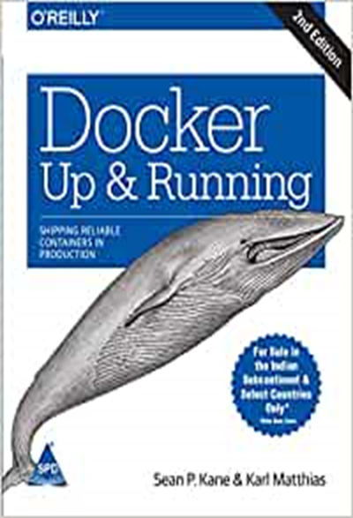
Resources
Text Book:
DOCKER DEEP DIVE by NIGEL POULTON, SHROFF/O'REILLY
References: 1. DOCKER: UP AND RUNNING by KARL
MATTHIAS, SEAN P. KANE, O'REILLY
2. JENKINS CONTINUOUS INTEGRATION COOKBOOK by ALAN MARK BERG, O'REILLY 3. JENKINS 2 UP AND RUNNING by BRENT LASTER, O'REILLY

Slide 22
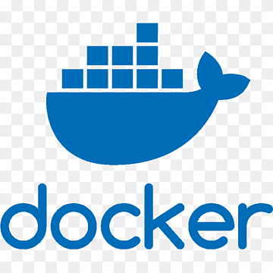
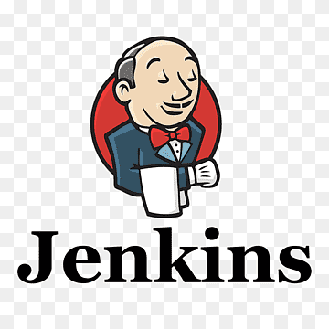
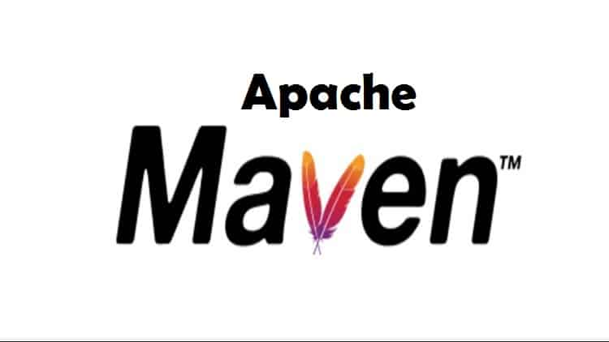
Tools & Platforms Used
Docker Desktop/AWS platform
Jenkins for CI/CD
Maven

Slide 23
Innovative Pedagogy
Discussion-based learning
Hands-on Practice
Case studies on real-world deployments with docker compose
CI/CD Pipeline through Github actions and Jenkins
BYOD practical approach

Slide 24
Practical Applications of the Course
Unit 1 – Practical Applications
Containers & DevOps Infrastructure
Deploying isolated applications using Docker on Linux/Windows
Used in industry by companies like Netflix, Uber, Walmart
Real-world use: Package once and run anywhere without conflicts
Docker Hub enables global sharing & versioning of application images

Slide 25
Practical Applications of the course
Unit 2– Practical Applications
Image Building, Networking & Storage
Building portable application containers using Docker file
Managing real projects with versioned container image repositories
Real-world use: Secure, repeatable deployments across teams and machines
Multi-host connectivity using Docker networks for backend + database

Slide 26
Practical Applications of the course
Unit 3– Practical Applications
Microservices & Docker Compose
Running multi-service apps (frontend/API/database) in one command
Used by modern platforms like Amazon, Swiggy, Meesho
Real-world use: Independent scaling, zero downtime updates
WordPress + MySQL deployment for blogging and e-commerce solutions

Slide 27
Practical Applications of the course
Unit 4– Practical Applications
Maven Build Automation
Packaging complete Java applications for production release
Used by enterprise software companies (TCS, Infosys, Capgemini)
Real-world use: Automatic dependency management & conflict resolution
CI-ready builds using Maven plugins, JUnit tests & packaged JAR/WAR files

Slide 28
Practical Applications of the course
Unit 5– Practical Applications
GitHub Actions – Continuous Integration
Automating build, test & deploy pipelines from GitHub repositories
Used by startups and open-source communities for fast releases
Real-world use: Automated testing prevents bugs from reaching production
Deploy containers to Docker Hub, AWS, Azure or Kubernetes clusters

Slide 29
Practical Applications of the course
Unit 6– Practical Applications
Jenkins CI/CD Pipelines
Orchestrating enterprise-level build → test → deploy pipelines
Used in large organizations like banks, telecom & SaaS platforms
Real-world use: Automatic deployments after every code commit
Jenkins plugins integrate with Docker, Maven & cloud servers for end-to-end delivery

Slide 30
Competitions & Recruitment Exams
Hackathons: Smart India Hackathon, DevOps Hackathons
Recruitment Roles: DevOps Engineer, Cloud Engineer, SRE, Automation Engineer
Eligibility Exams: GATE (CS/IT), Company-specific coding rounds
Certifications: AWS DevOps Engineer, Docker Certified Associate (DCA), GitHub Actions Certification.

Slide 31
Skill Attainment Through INT332
Docker and Containerization
Image building & registry management
Microservices deployment using Compose
Maven lifecycle automation
GitHub Actions CI workflows
Jenkins CI/CD pipelines
DevOps pipelines from build to deploy
Practical cloud-ready DevOps skills

Slide 32
Outcome of Zero Lecture
Students understand course roadmap, units, and learning objectives
Introduction to core DevOps tools: Docker, Maven, GitHub Actions, Jenkins
Awareness of evaluation pattern, labs, assignments, and project requirements
Real-world relevance of containerization and CI/CD in modern software delivery
Students recognize industry demand and career opportunities in DevOps & Cloud

Slide 33
Need to Learn Docker

Slide 34
Virtualization and containerization
With the changing times, businesses started looking for solutions to reduce overhead costs, enhance scalability, and standardize application deployment process.
They started considering the following two approaches to reduce costs −
Virtualization
Containerization

Slide 35
What is Virtualization?
Virtualization is the process of partitioning a physical server into multiple virtual servers.
The process of partitioning is carried out using a software called 'hypervisor'.
After partitioning, the virtual servers act and perform just as a physical server.
Essentially, it means using the same hardware set-up more efficiently, thereby freeing the resources for other tasks or retiring the resources altogether.

Slide 36
Advantages of Virtualization
Enhanced performance
Promotes agile IT infrastructure
Promotes use of resources in optimum manner
Better disaster management if any physical hazards take place to resources
Better security as the infected VM can be isolated from other VMs and the host server
Space saving
The capital investment cost on hardware is saved, and thereby maintenance cost is saved, hence overall cost savings for a business.

Slide 37
For example, instead of dedicating 1 server and 1 operating system to execute 1 dedicated task, the same server is partitioned such as 1 server and 2 operating systems, which can allow independent tasks running on each of them.

Slide 38
What is Containerization?

Slide 39
EDU-Revolution Categories
Revenue Generation
Social Media Presence
Project
Recognition of Prior Learning
NPTEL/MOOC
Grade Upgradation (Core/Non-Core)
Internship Beyond the Curriculum
Community Service
Co-curricular/Extra curricular activities
10% Attendance Benefit
Duty Leave
Earn Extra Credit

Slide 40


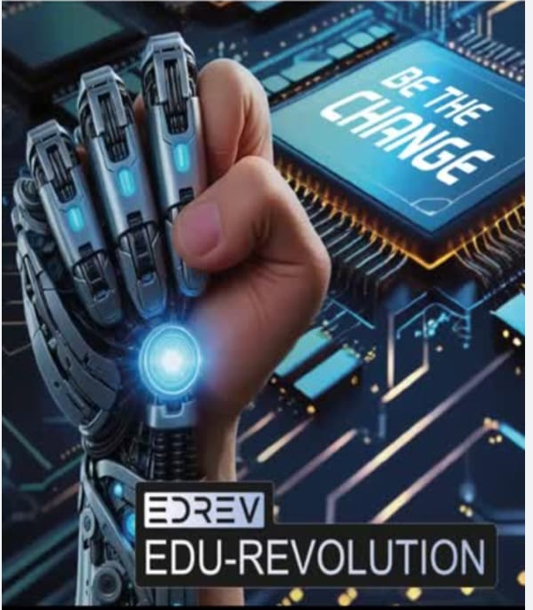
www.lpu.in Lovely Professional University

Slide 41

THEME OF EDUCATION REVOLUTION
GAMIFIED LEARNING

Slide 42
The Beginning: BE THE CHANGE
Personalized, Student-Centric Learning: Tailored academic pathways to meet individual learning needs.
Beyond the Classroom: Enabling students to explore, engage, and excel through flexible learning platforms.
Academic Agility: Freedom to choose and customize key academic areas to match students' aspirations.
Real-World Integration: Moving beyond traditional pen-and-paper methods to hands-on, practical learning.
Experiential Learning Focus: Bridging theory with real-world practice to enhance skills and competencies.
Holistic Development: Fostering intellectual, emotional, and social growth for well-rounded graduates.

Slide 43
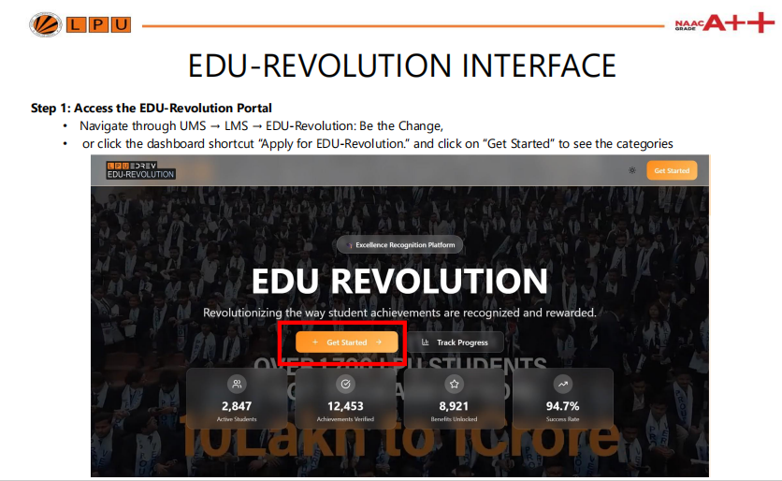

Slide 44

EDU-REVOLUTION INTERFACE
Step 2: Choose a Category
Select the category for which you want to submit your nomination.

Slide 45
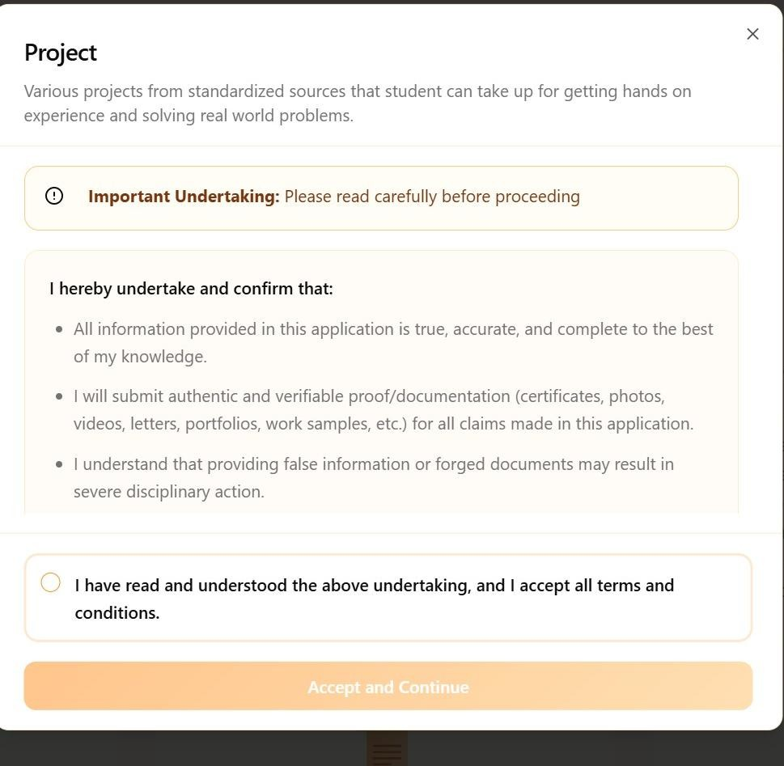
EDU-REVOLUTION INTERFACE
Step 3 : Read the undertaking carefully
Click on Accept and continue to see the course list.

Slide 46
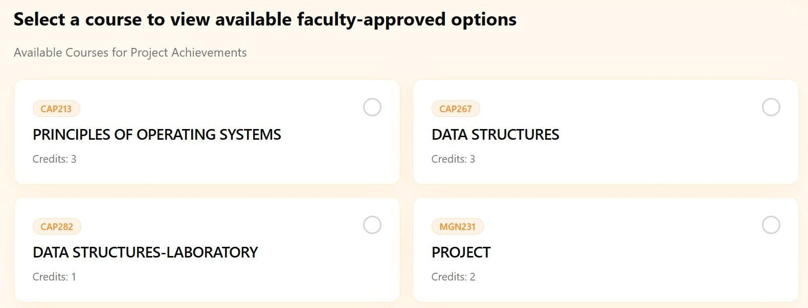
Step 4: Review Expert-Defined Options
Explore the list of courses in which you can express your interest.

Slide 47
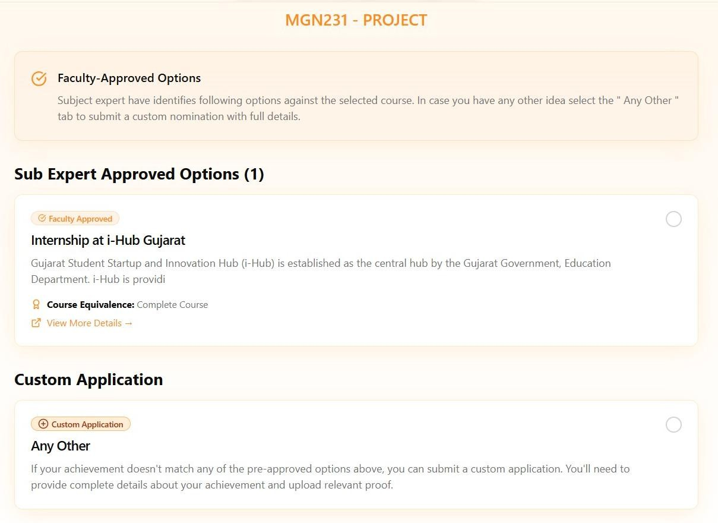
Step :: 5 Review Expert-Defined Options
Explore the list of course-specific options
curated by subject experts, where you can express your interest.

Slide 48
Step 5 (a) ::Use the “Any Other” Option if Needed
If your preferred option is not listed, choose the “Any Other” option shown under the course.

Slide 49
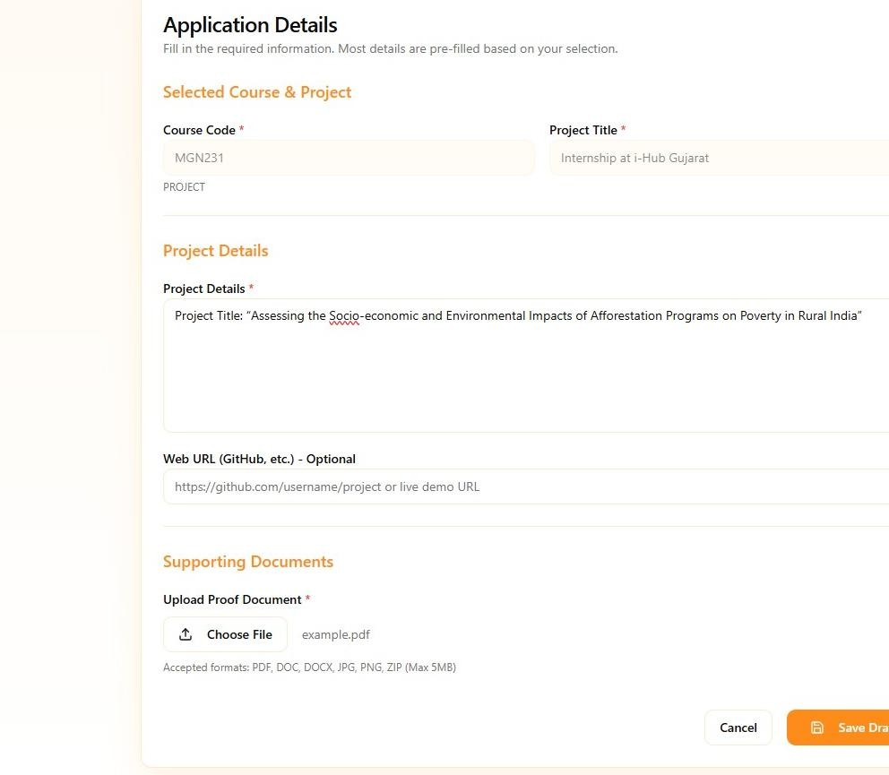
Step 6:: Fill all the relevant details and upload the required proof and click on save draft

Slide 50
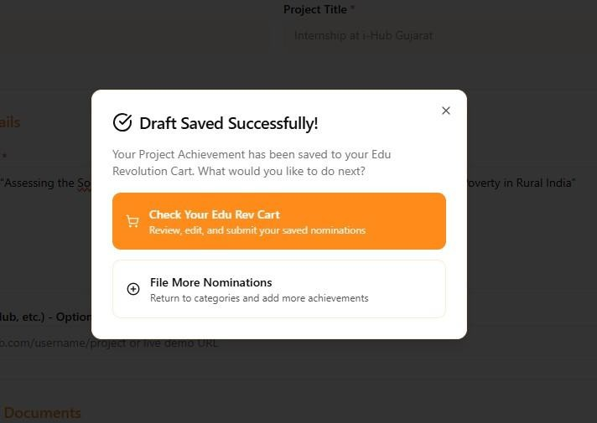

Step 7 :: Your nomination shall be added in the EDU-Revolution Cart: Which you can Review, Modify, and Remove

Slide 51
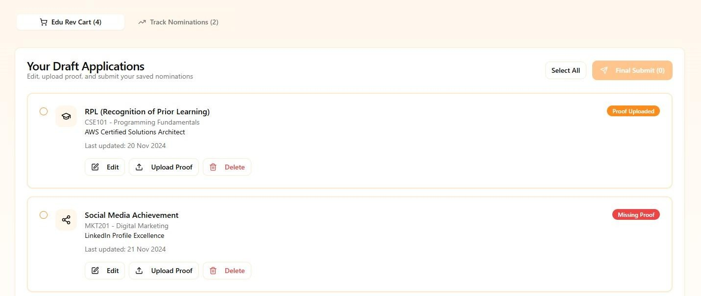
Step 8:: Your nomination shall be added in the EDU-Revolution Cart: Which you can Review, Modify, and Remove. You have to click on “Final Submit” for submission of your nominations.

Slide 52
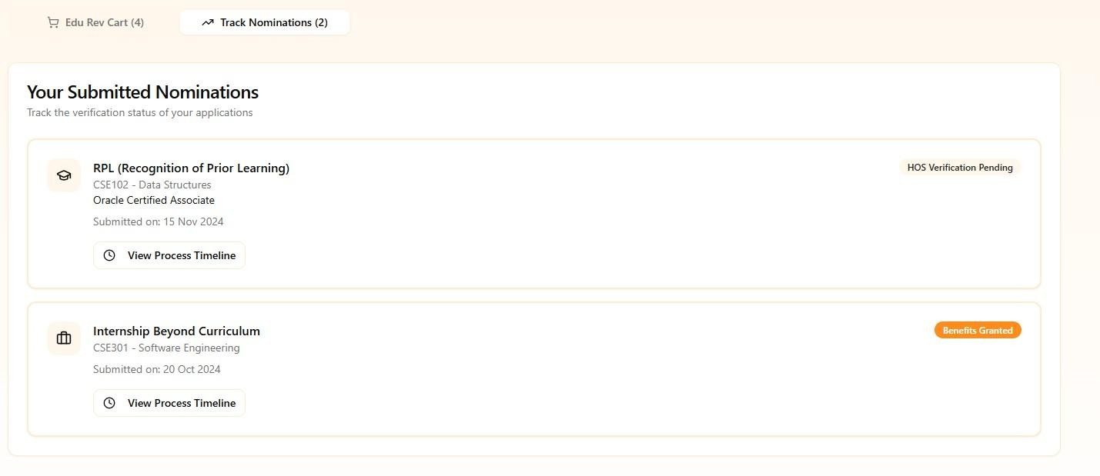
Your can track the progress from the Track Progress tab provided

Slide 53
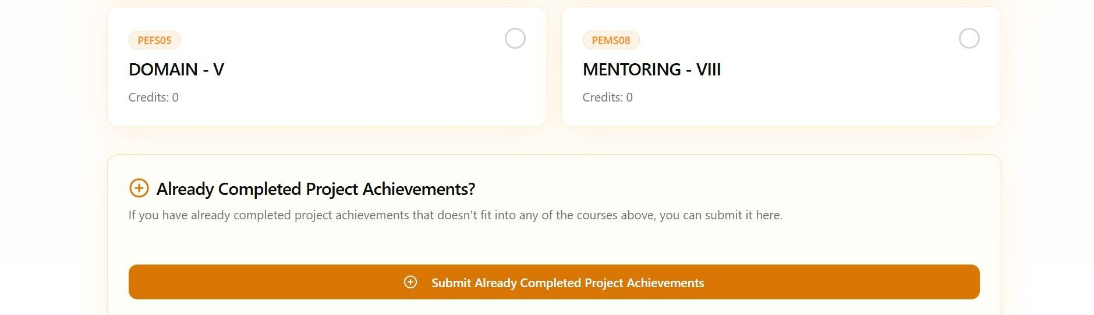
Submit Completed Initiatives
If you have already completed an initiative, upload your achievement using the “Already Completed” button and repeat the steps from Step-6 to Step-8

Slide 54
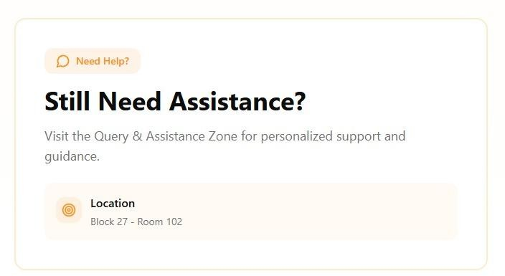
Query and Assistance Zone

Slide 55
Edu-Revolution
Consider applying on UMS > LMS > Edu-Revolution benefits
OR in LPU touch
Consider applying for Edu-revolution in this term, the options are:
RPL- Recognised prior learning Gain benefits on the basis of previously learnt subject and get exempted on current subject. Before the start of each term, students who believe they already possess the required knowledge or skills in a course registered to him/her in upcoming term, can request a relaxation from the course and attendance via an online interface. | CARE- Continuous Assessment Reduction through Experience Gain benefits towards your alternative approaches may apply for CA modifications by opting for real-life problem-solving assignments, social service, blogs, vlogs on social media etc . The course teacher will provide details about the various CA options available for the course during the Zero Lecture.
10 % Attendance waiver for students in Pre-final/Final year of the program. Students with a CGPA of 8 or higher can apply for an attendance relaxation in their pre-final/final year. Eligible students will be granted a 10% attendance relaxation to support their career development for pursuing the following aspirations | GROW- Grade Revision and Overall Welfare Gain benefits by participating in internationally or nationally recognized competitions or hackathons to request for grade upgradation in an equivalent course studied in current/previous terms.
55
www.lpu.in Lovely Professional University

Slide 56
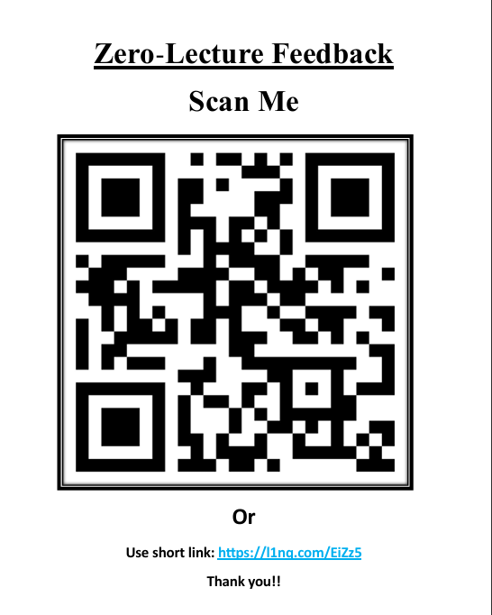

Slide 57

Next Class: Basics of DevOps Infrastructure

Slide 58
THANKS
Any Queries!

